Slide 1



Convolution Neural Network
Winter School
on
Deep Learning for Vision and Language Modelling
Organized by
Multimedia Lab, Department of Computer Science and Engineering
Indian Institute of Technology Guwahati
Arijit Sur
January 7, 2025

Slide 2
Background: Image Processing
A convolution matrix is used in image processing for tasks such as edge detection, blurring, sharpening, etc.
Input Image
0 | 0 | 0 | 0 | 0 | 0 | 0
0 | 1 | 1 | 1 | 1 | 1 | 0
0 | 1 | 0 | 0 | 1 | 0 | 0
0 | 1 | 0 | 1 | 0 | 0 | 0
0 | 1 | 1 | 0 | 0 | 0 | 0
0 | 1 | 0 | 0 | 0 | 0 | 0
0 | 0 | 0 | 0 | 0 | 0 | 0
Convolved Image
Convolution
1 | 1 | 1 | 1 | 1
1 | 0 | 0 | 1 | 0
1 | 0 | 1 | 0 | 0
1 | 1 | 0 | 0 | 0
1 | 0 | 0 | 0 | 0
0 | 0 | 0
0 | 1 | 1
0 | 1 | 0

Slide 3
Background: Image Processing
A convolution matrix is used in image processing for tasks such as edge detection, blurring, sharpening, etc.
Input Image
0 | 0 | 0 | 0 | 0 | 0 | 0
0 | 1 | 1 | 1 | 1 | 1 | 0
0 | 1 | 0 | 0 | 1 | 0 | 0
0 | 1 | 0 | 1 | 0 | 0 | 0
0 | 1 | 1 | 0 | 0 | 0 | 0
0 | 1 | 0 | 0 | 0 | 0 | 0
0 | 0 | 0 | 0 | 0 | 0 | 0
Convolved Image
Convolution
3 | 2 | 2 | 3 | 1
2 | 0 | 2 | 1 | 0
2 | 2 | 1 | 0 | 0
3 | 1 | 0 | 0 | 0
1 | 0 | 0 | 0 | 0
0 | 0 | 0
0 | 1 | 1
0 | 1 | 0

Slide 4
Background: Image Processing
A convolution matrix is used in image processing for tasks such as edge detection, blurring, sharpening, etc.
Input Image
0 | 0 | 0 | 0 | 0 | 0 | 0
0 | 1 | 1 | 1 | 1 | 1 | 0
0 | 1 | 0 | 0 | 1 | 0 | 0
0 | 1 | 0 | 1 | 0 | 0 | 0
0 | 1 | 1 | 0 | 0 | 0 | 0
0 | 1 | 0 | 0 | 0 | 0 | 0
0 | 0 | 0 | 0 | 0 | 0 | 0
Convolved Image
Convolution
3 | 2 | 2 | 3 | 1
2 | 0 | 2 | 1 | 0
2 | 2 | 1 | 0 | 0
3 | 1 | 0 | 0 | 0
1 | 0 | 0 | 0 | 0

Slide 5
Background: Image Processing
A convolution matrix is used in image processing for tasks such as edge detection, blurring, sharpening, etc.
Input Image
0 | 0 | 0 | 0 | 0 | 0 | 0
0 | 1 | 1 | 1 | 1 | 1 | 0
0 | 1 | 0 | 0 | 1 | 0 | 0
0 | 1 | 0 | 1 | 0 | 0 | 0
0 | 1 | 1 | 0 | 0 | 0 | 0
0 | 1 | 0 | 0 | 0 | 0 | 0
0 | 0 | 0 | 0 | 0 | 0 | 0
Convolved Image
Convolution
3 | 2 | 2 | 3 | 1
2 | 0 | 2 | 1 | 0
2 | 2 | 1 | 0 | 0
3 | 1 | 0 | 0 | 0
1 | 0 | 0 | 0 | 0

Slide 6
Background: Image Processing
A convolution matrix is used in image processing for tasks such as edge detection, blurring, sharpening, etc.
Input Image
0 | 0 | 0 | 0 | 0 | 0 | 0
0 | 1 | 1 | 1 | 1 | 1 | 0
0 | 1 | 0 | 0 | 1 | 0 | 0
0 | 1 | 0 | 1 | 0 | 0 | 0
0 | 1 | 1 | 0 | 0 | 0 | 0
0 | 1 | 0 | 0 | 0 | 0 | 0
0 | 0 | 0 | 0 | 0 | 0 | 0
Convolved Image
Convolution
3 | 2 | 2 | 3 | 1
2 | 0 | 2 | 1 | 0
2 | 2 | 1 | 0 | 0
3 | 1 | 0 | 0 | 0
1 | 0 | 0 | 0 | 0

Slide 7
Background: Image Processing
A convolution matrix is used in image processing for tasks such as edge detection, blurring, sharpening, etc.
Input Image
0 | 0 | 0 | 0 | 0 | 0 | 0
0 | 1 | 1 | 1 | 1 | 1 | 0
0 | 1 | 0 | 0 | 1 | 0 | 0
0 | 1 | 0 | 1 | 0 | 0 | 0
0 | 1 | 1 | 0 | 0 | 0 | 0
0 | 1 | 0 | 0 | 0 | 0 | 0
0 | 0 | 0 | 0 | 0 | 0 | 0
Convolved Image
Convolution
3

Slide 8
Background: Image Processing
A convolution matrix is used in image processing for tasks such as edge detection, blurring, sharpening, etc.
Input Image
0 | 0 | 0 | 0 | 0 | 0 | 0
0 | 1 | 1 | 1 | 1 | 1 | 0
0 | 1 | 0 | 0 | 1 | 0 | 0
0 | 1 | 0 | 1 | 0 | 0 | 0
0 | 1 | 1 | 0 | 0 | 0 | 0
0 | 1 | 0 | 0 | 0 | 0 | 0
0 | 0 | 0 | 0 | 0 | 0 | 0
Convolved Image
Convolution
3 | 2

Slide 9
Background: Image Processing
A convolution matrix is used in image processing for tasks such as edge detection, blurring, sharpening, etc.
Input Image
0 | 0 | 0 | 0 | 0 | 0 | 0
0 | 1 | 1 | 1 | 1 | 1 | 0
0 | 1 | 0 | 0 | 1 | 0 | 0
0 | 1 | 0 | 1 | 0 | 0 | 0
0 | 1 | 1 | 0 | 0 | 0 | 0
0 | 1 | 0 | 0 | 0 | 0 | 0
0 | 0 | 0 | 0 | 0 | 0 | 0
Convolved Image
Convolution
3 | 2 | 2

Slide 10
Background: Image Processing
A convolution matrix is used in image processing for tasks such as edge detection, blurring, sharpening, etc.
Input Image
0 | 0 | 0 | 0 | 0 | 0 | 0
0 | 1 | 1 | 1 | 1 | 1 | 0
0 | 1 | 0 | 0 | 1 | 0 | 0
0 | 1 | 0 | 1 | 0 | 0 | 0
0 | 1 | 1 | 0 | 0 | 0 | 0
0 | 1 | 0 | 0 | 0 | 0 | 0
0 | 0 | 0 | 0 | 0 | 0 | 0
Convolved Image
Convolution
3 | 2 | 2 | 3

Slide 11
Background: Image Processing
A convolution matrix is used in image processing for tasks such as edge detection, blurring, sharpening, etc.
Input Image
0 | 0 | 0 | 0 | 0 | 0 | 0
0 | 1 | 1 | 1 | 1 | 1 | 0
0 | 1 | 0 | 0 | 1 | 0 | 0
0 | 1 | 0 | 1 | 0 | 0 | 0
0 | 1 | 1 | 0 | 0 | 0 | 0
0 | 1 | 0 | 0 | 0 | 0 | 0
0 | 0 | 0 | 0 | 0 | 0 | 0
Convolved Image
Convolution
3 | 2 | 2 | 3 | 1

Slide 12
Background: Image Processing
A convolution matrix is used in image processing for tasks such as edge detection, blurring, sharpening, etc.
Input Image
0 | 0 | 0 | 0 | 0 | 0 | 0
0 | 1 | 1 | 1 | 1 | 1 | 0
0 | 1 | 0 | 0 | 1 | 0 | 0
0 | 1 | 0 | 1 | 0 | 0 | 0
0 | 1 | 1 | 0 | 0 | 0 | 0
0 | 1 | 0 | 0 | 0 | 0 | 0
0 | 0 | 0 | 0 | 0 | 0 | 0
Convolved Image
Convolution
3 | 2 | 2 | 3 | 1
2

Slide 13
Background: Image Processing
A convolution matrix is used in image processing for tasks such as edge detection, blurring, sharpening, etc.
Input Image
0 | 0 | 0 | 0 | 0 | 0 | 0
0 | 1 | 1 | 1 | 1 | 1 | 0
0 | 1 | 0 | 0 | 1 | 0 | 0
0 | 1 | 0 | 1 | 0 | 0 | 0
0 | 1 | 1 | 0 | 0 | 0 | 0
0 | 1 | 0 | 0 | 0 | 0 | 0
0 | 0 | 0 | 0 | 0 | 0 | 0
Convolved Image
Convolution
3 | 2 | 2 | 3 | 1
2 | 0

Slide 14
Background: Image Processing
A convolution matrix is used in image processing for tasks such as edge detection, blurring, sharpening, etc.
Input Image
0 | 0 | 0 | 0 | 0 | 0 | 0
0 | 1 | 1 | 1 | 1 | 1 | 0
0 | 1 | 0 | 0 | 1 | 0 | 0
0 | 1 | 0 | 1 | 0 | 0 | 0
0 | 1 | 1 | 0 | 0 | 0 | 0
0 | 1 | 0 | 0 | 0 | 0 | 0
0 | 0 | 0 | 0 | 0 | 0 | 0
Convolved Image
Convolution
3 | 2 | 2 | 3 | 1
2 | 0 | 2 | 1 | 0
2 | 2 | 1 | 0 | 0
3 | 1 | 0 | 0 | 0
1 | 0 | 0 | 0 | 0

Slide 15
Background: Image Processing
A convolution matrix is used in image processing for tasks such as edge detection, blurring, sharpening, etc.
Input Image
0 | 0 | 0 | 0 | 0 | 0 | 0
0 | 1 | 1 | 1 | 1 | 1 | 0
0 | 1 | 0 | 0 | 1 | 0 | 0
0 | 1 | 0 | 1 | 0 | 0 | 0
0 | 1 | 1 | 0 | 0 | 0 | 0
0 | 1 | 0 | 0 | 0 | 0 | 0
0 | 0 | 0 | 0 | 0 | 0 | 0
Convolved Image
Identity Convolution
1 | 1 | 1 | 1 | 1
1 | 0 | 0 | 1 | 0
1 | 0 | 1 | 0 | 0
1 | 1 | 0 | 0 | 0
1 | 0 | 0 | 0 | 0
0 | 0 | 0
0 | 1 | 0
0 | 0 | 0

Slide 16
Background: Image Processing
A convolution matrix is used in image processing for tasks such as edge detection, blurring, sharpening, etc.
Input Image
0 | 0 | 0 | 0 | 0 | 0 | 0
0 | 1 | 1 | 1 | 1 | 1 | 0
0 | 1 | 0 | 0 | 1 | 0 | 0
0 | 1 | 0 | 1 | 0 | 0 | 0
0 | 1 | 1 | 0 | 0 | 0 | 0
0 | 1 | 0 | 0 | 0 | 0 | 0
0 | 0 | 0 | 0 | 0 | 0 | 0
Convolved Image
Blurring Convolution
.4 | .5 | .5 | .5 | .4
.4 | .2 | .3 | .6 | .3
.5 | .4 | .4 | .2 | .1
.5 | .6 | .2 | .1 | 0
.4 | .3 | .1 | 0 | 0
.1 | .1 | .1
.1 | .2 | .1
.1 | .1 | .1

Slide 17
Background: Image Processing
A convolution matrix is used in image processing for tasks such as edge detection, blurring, sharpening, etc.
Input Image
0 | 0 | 0 | 0 | 0 | 0 | 0
0 | 1 | 1 | 1 | 1 | 1 | 0
0 | 1 | 0 | 0 | 1 | 0 | 0
0 | 1 | 0 | 1 | 0 | 0 | 0
0 | 1 | 1 | 0 | 0 | 0 | 0
0 | 1 | 0 | 0 | 0 | 0 | 0
0 | 0 | 0 | 0 | 0 | 0 | 0
Convolved Image
Blurring Convolution
.4 | .5 | .5 | .5 | .4
.4 | .2 | .3 | .6 | .3
.5 | .4 | .4 | .2 | .1
.5 | .6 | .2 | .1 | 0
.4 | .3 | .1 | 0 | 0
.1 | .1 | .1
.1 | .2 | .1
.1 | .1 | .1

Slide 18
Convolutional Neural Network (CNN)
CNN key idea: Treat convolution matrix as parameters and learn them!
Input Image
0 | 0 | 0 | 0 | 0 | 0 | 0
0 | 1 | 1 | 1 | 1 | 1 | 0
0 | 1 | 0 | 0 | 1 | 0 | 0
0 | 1 | 0 | 1 | 0 | 0 | 0
0 | 1 | 1 | 0 | 0 | 0 | 0
0 | 1 | 0 | 0 | 0 | 0 | 0
0 | 0 | 0 | 0 | 0 | 0 | 0
Convolved Image
Learned Convolution
.4 | .5 | .5 | .5 | .4
.4 | .2 | .3 | .6 | .3
.5 | .4 | .4 | .2 | .1
.5 | .6 | .2 | .1 | 0
.4 | .3 | .1 | 0 | 0
θ₁₁ | θ₁₂ | θ₁₃
θ₂₁ | θ₂₂ | θ₂₃
θ₃₁ | θ₃₂ | θ₃₃

Slide 19
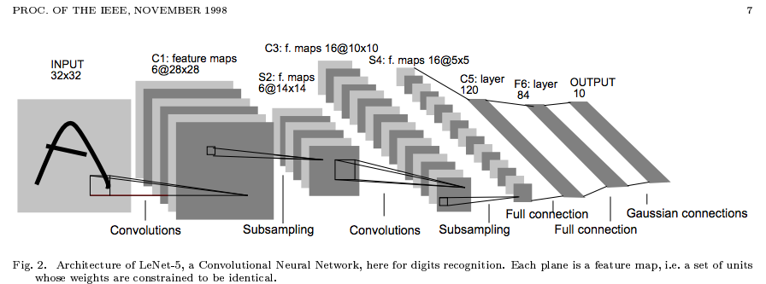
Convolutional Neural Network (CNN)
Typical layers include:
Convolutional layer
Max-pooling layer
Fully connected layer
(Nonlinear) Normalization layer
Softmax
These can be arranged into arbitrarily deep topologies

Slide 20
Convolution
Visual Interpretation

Slide 21
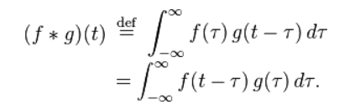
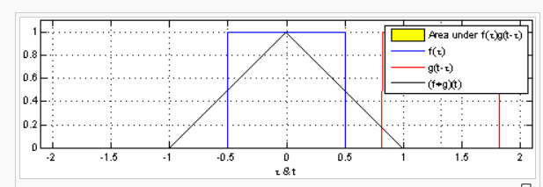
What’s a convolution?
1-D
Slide from William Cohen

Slide 22
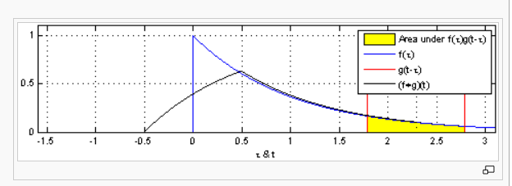
What’s a convolution?
1-D
Slide from William Cohen

Slide 23
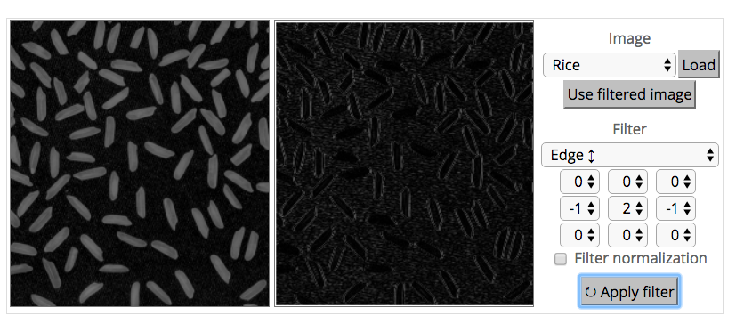
What’s a convolution?
Source: http://matlabtricks.com/post-5/3x3-convolution-kernels-with-online-demo
Slide from William Cohen

Slide 24
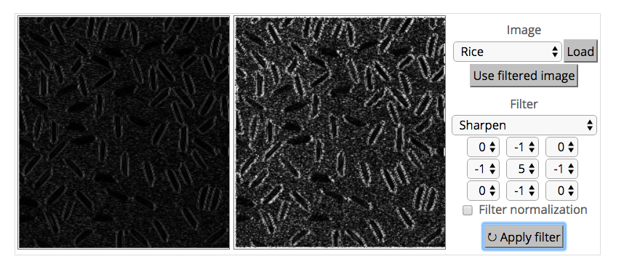
What’s a convolution?
http://matlabtricks.com/post-5/3x3-convolution-kernels-with-online-demo
Slide from William Cohen

Slide 25
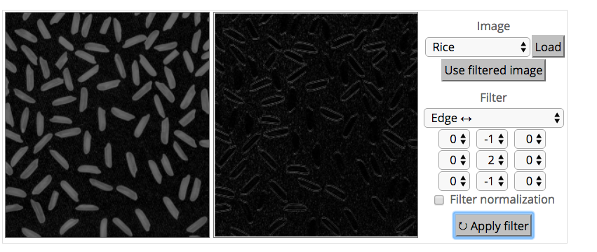
What’s a convolution?
http://matlabtricks.com/post-5/3x3-convolution-kernels-with-online-demo
Slide from William Cohen

Slide 26
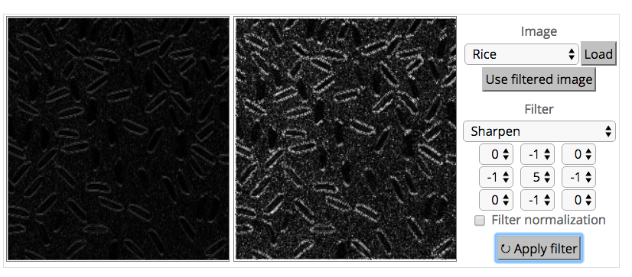
What’s a convolution?
http://matlabtricks.com/post-5/3x3-convolution-kernels-with-online-demo
Slide from William Cohen

Slide 27
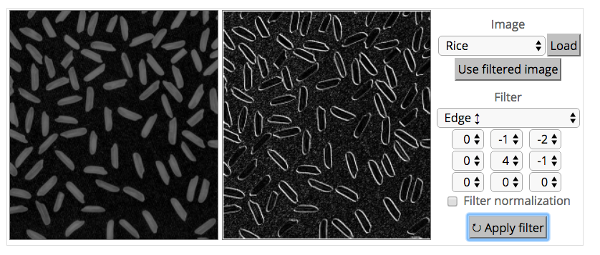
What’s a convolution?
http://matlabtricks.com/post-5/3x3-convolution-kernels-with-online-demo
Slide from William Cohen

Slide 28
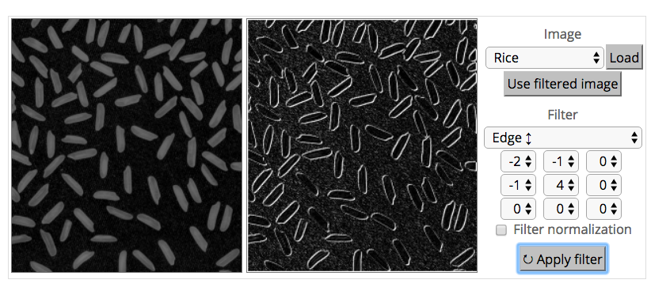
What’s a convolution?
http://matlabtricks.com/post-5/3x3-convolution-kernels-with-online-demo
Slide from William Cohen

Slide 29
What’s a convolution?
Basic idea:
Pick a 3x3 matrix F of weights
Slide this over an image and compute the “inner product” (similarity) of F and the corresponding field of the image, and replace the pixel in the center of the field with the output of the inner product operation
Key point:
Different convolutions extract different types of low-level “features” from an image
All that we need to vary to generate these different features is the weights of F
Slide from William Cohen

Slide 30
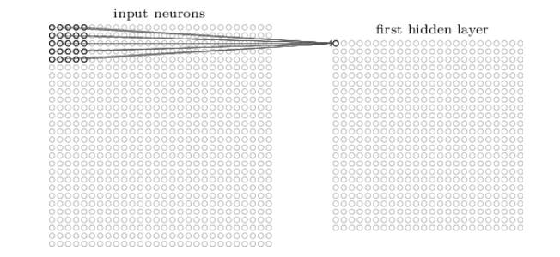
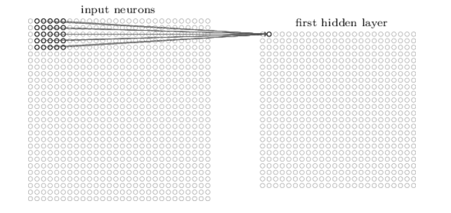
How do we convolve an image with an ANN?
Note that the parameters in the matrix defining the convolution are tied across all places that it is used
Slide from William Cohen

Slide 31
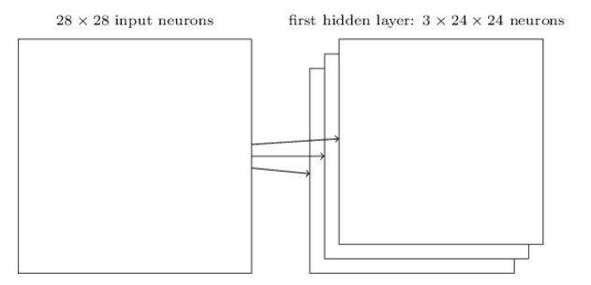
How do we do many convolutions of an image with an ANN?
Slide from William Cohen

Slide 32
Convolution of a Color Image
Color images consist of 3 floats per pixel for RGB (red, green blue) color values
Convolution must also be 3-dimensional
Figure from Fei-Fei Li & Andrej Karpathy & Justin Johnson (CS231N)

Slide 33
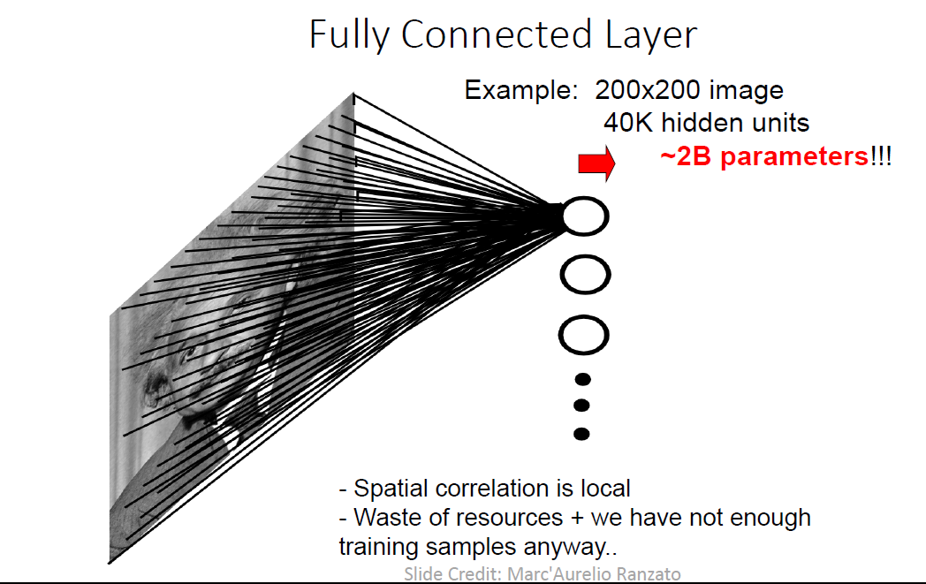
Naïve CNN Architecture

Slide 34
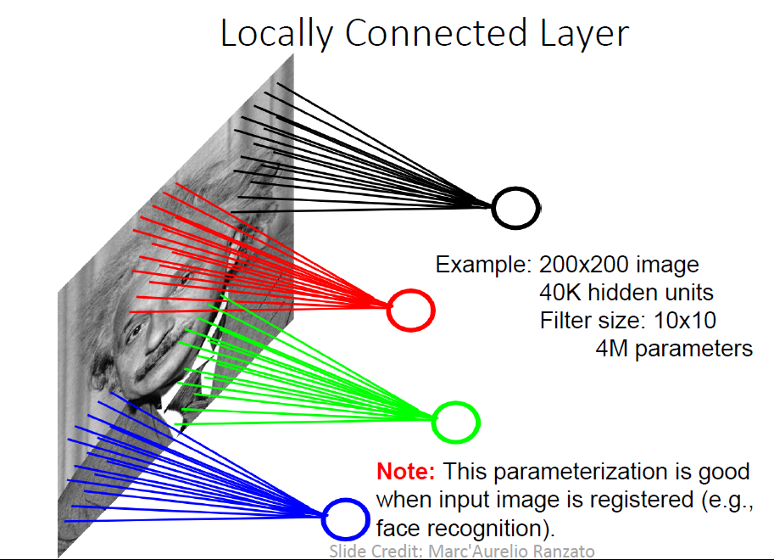
Naïve CNN Architecture

Slide 35
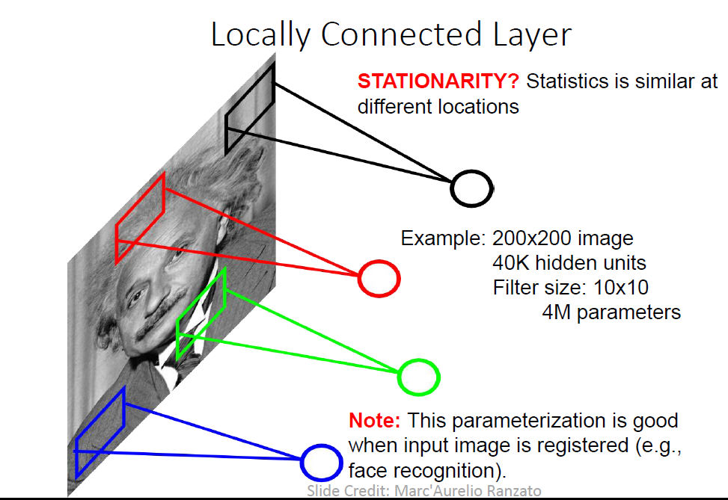
Naïve CNN Architecture

Slide 36
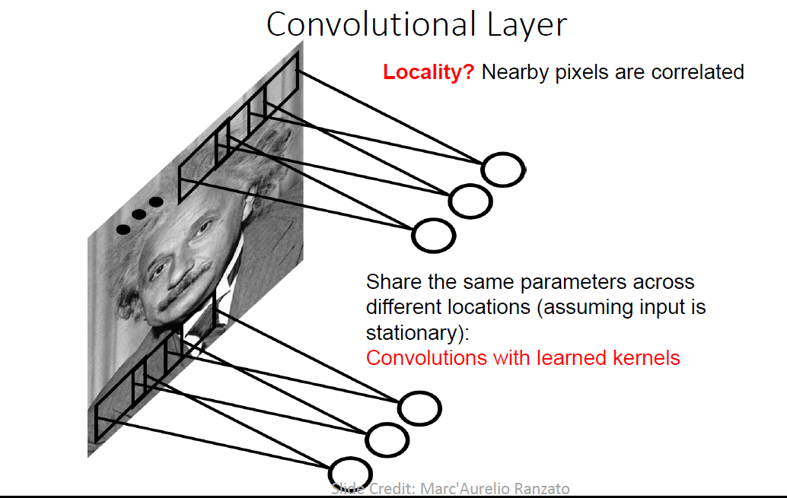
Naïve CNN Architecture

Slide 37
Convolution: Example

Slide 38
Convolution Layer

Slide 39
Convolution Layer

Slide 40
Convolution Layer

Slide 41
CNN: Summary

Slide 42
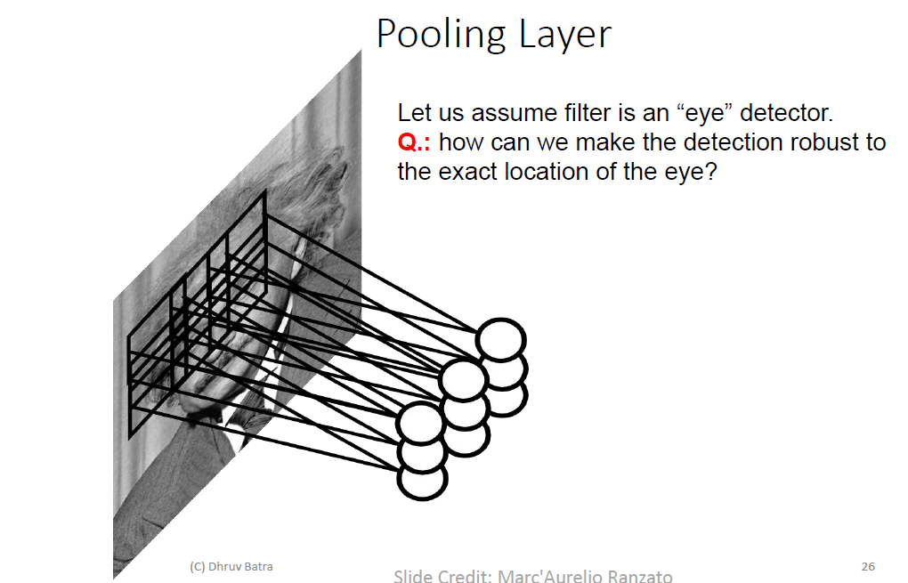
Pooling

Slide 43
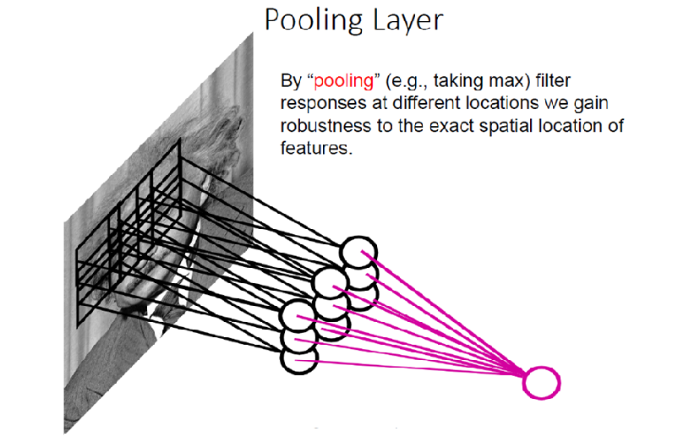
Pooling

Slide 44
Max-pooling
Figure from Fei-Fei Li & Andrej Karpathy & Justin Johnson (CS231N)

Slide 45
Max-pooling
Figure from Fei-Fei Li & Andrej Karpathy & Justin Johnson (CS231N)

Slide 46
Why do max-pooling?
Saves space
Reduces overfitting?
Because I’m going to add more convolutions after it!
Allows the short-range convolutions to extend over larger subfields of the images
So we can spot larger objects
Eg, a long horizontal line, or a corner, or …
Slide from William Cohen

Slide 47
Different Pooling

Slide 48
Pooling: Visual Interpretation

Slide 49
Pooling: Visual Interpretation

Slide 50
Pooling Layer: Receptive Field Size

Slide 51
Local Contrast Normalization

Slide 52
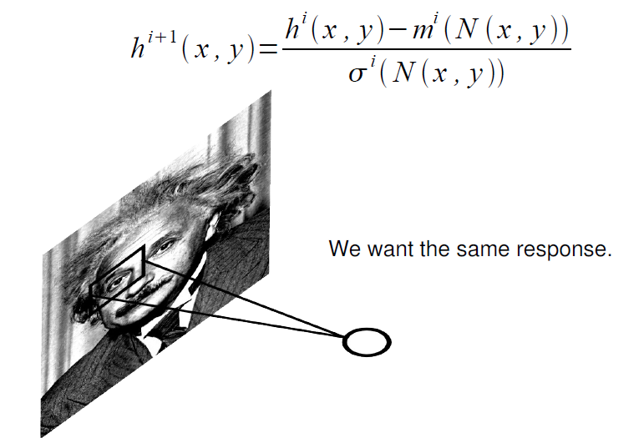
Local Contrast Normalization

Slide 53
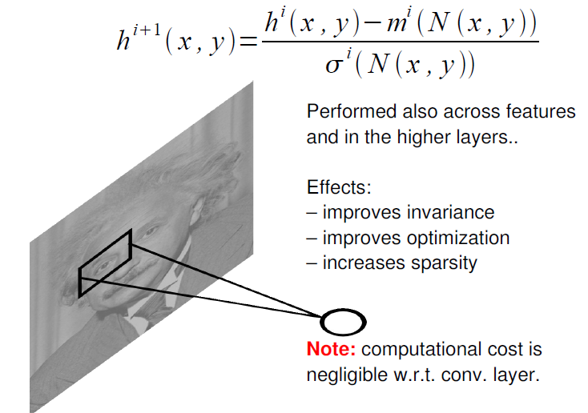
Local Contrast Normalization

Slide 54
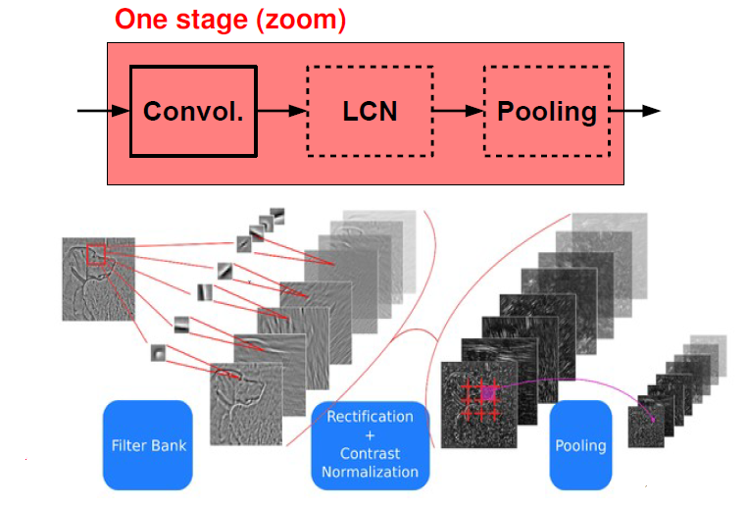
Stages of CNN

Slide 55
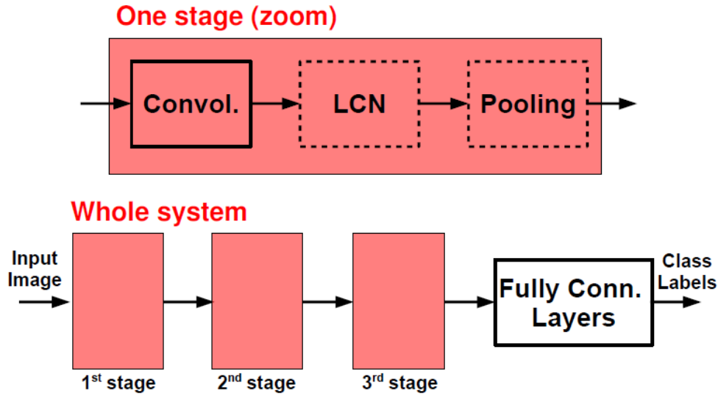
Typical CNN Architecture

Slide 56
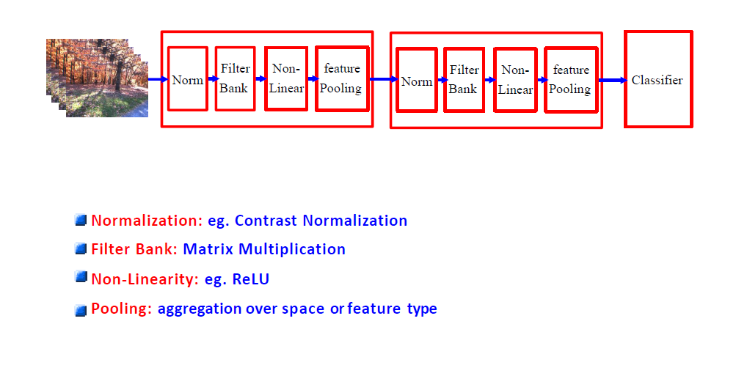
Typical CNN Architecture

Slide 57
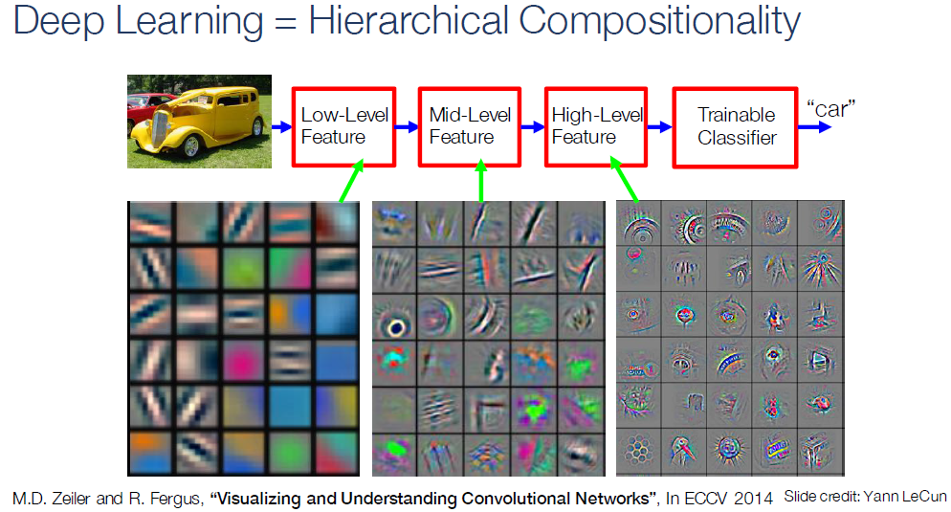

Slide 58
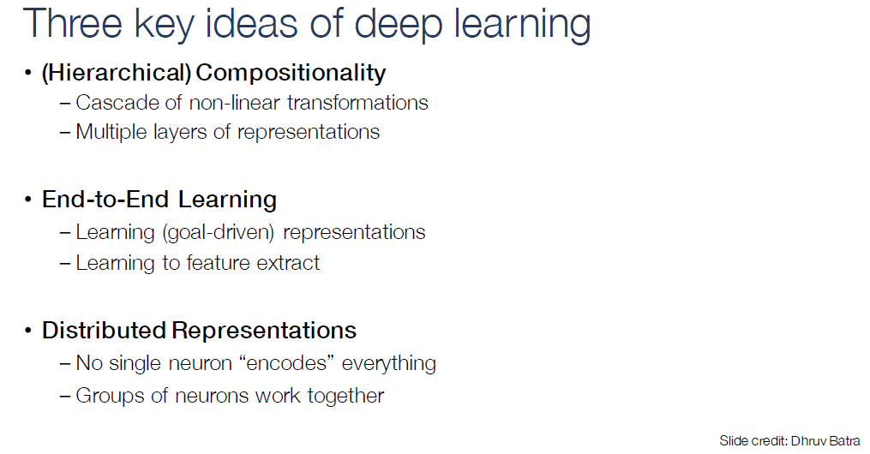

Slide 59
CNNs for Image Recognition
Slide from Kaiming He

